Slide 1
moving objects & Stall Detection
Arvind Seshan

Slide 2
Lesson Objectives
Learn how to move non-drive motors
Learn about motor stalls
Note: Although images shown may be a SPIKE Prime, the same techniques apply to Robot Inventor

Slide 3
Single Motor Functions (Actions)
To control motors, they must first be initialized
motor = Motor('D')
To run for a certain duration, use
run_for_degrees(degrees, speed=None)
run_for_rotations(rotations, speed=None)
run_for_seconds(seconds, speed=None)
To start running the motors, until stopped at a later spot
start(speed=None)
start_at_power(power)
stop()
To run the motor to a specific location
run_to_degrees_counted(degrees, speed=None)
run_to_position(degrees, direction='shortest path', speed=None)
'clockwise' 'counterclockwise'

Slide 4
Single Motor Functions (Measurements/Settings)
The rotation sensor in the motor can be used to tell the number of degrees the motor has turned
To do this, use set_degrees_counted(degrees_counted) and get_degrees_counted()
Just like motor pairs, you can alter various settings
set_stop_action(action)
set_default_speed(default_speed)
You can also read different measurements associated with the motor
get_speed()
get_position()
get_default_speed()
'coast'
'brake'
'hold'

Slide 5
Stall detection
Often times, you program the motor to move a particular amount. However, the motor gets stuck before it reaches that amount.
Stall Detection allows your program to automatically move on to the next line in the code when a particular motor command is stuck (unable to complete its move)
SPIKE Prime has a built-in Stall Detection
By default, Stall Detection is on when using single motor functions. However, you can turn this feature off using this function:
set_stall_detection(False)
You can even detect if a motor stall or interrupt has occurred by doing
was_stalled()
was_interrupted()

Slide 6
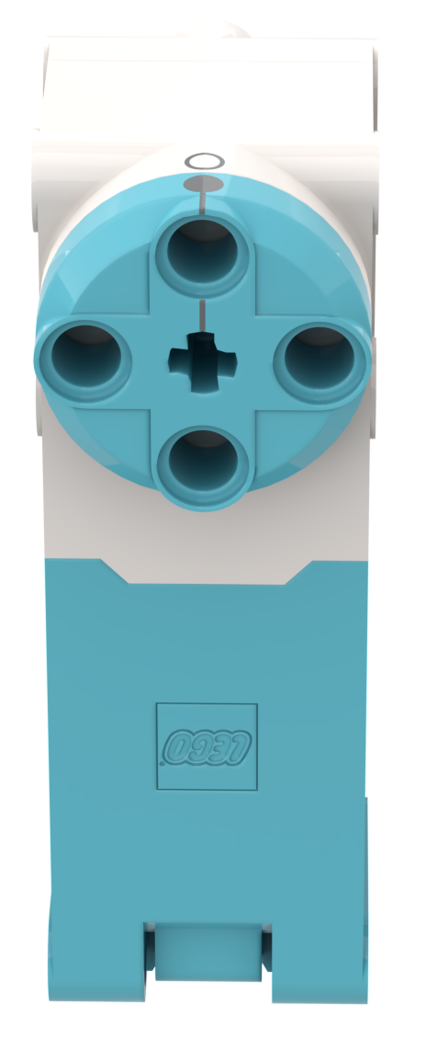
NEGATIVE Values
You can enter negative values for power or distance
This will make the robot move backwards
If you negate two values (e.g. power and distance or distance and backwards direction), the robot will move forward.
Negative Power = Backwards
Positive Power = Forward

Slide 7
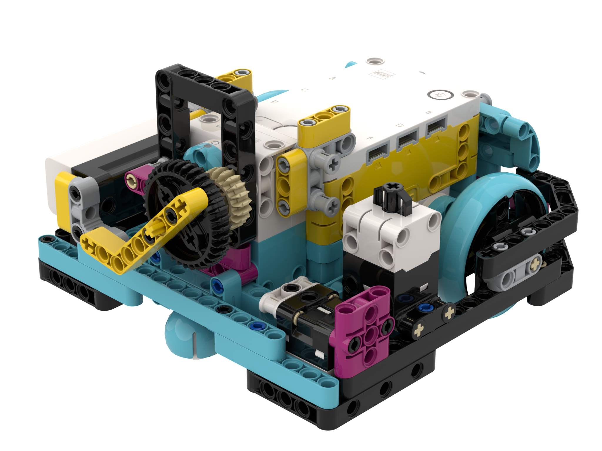
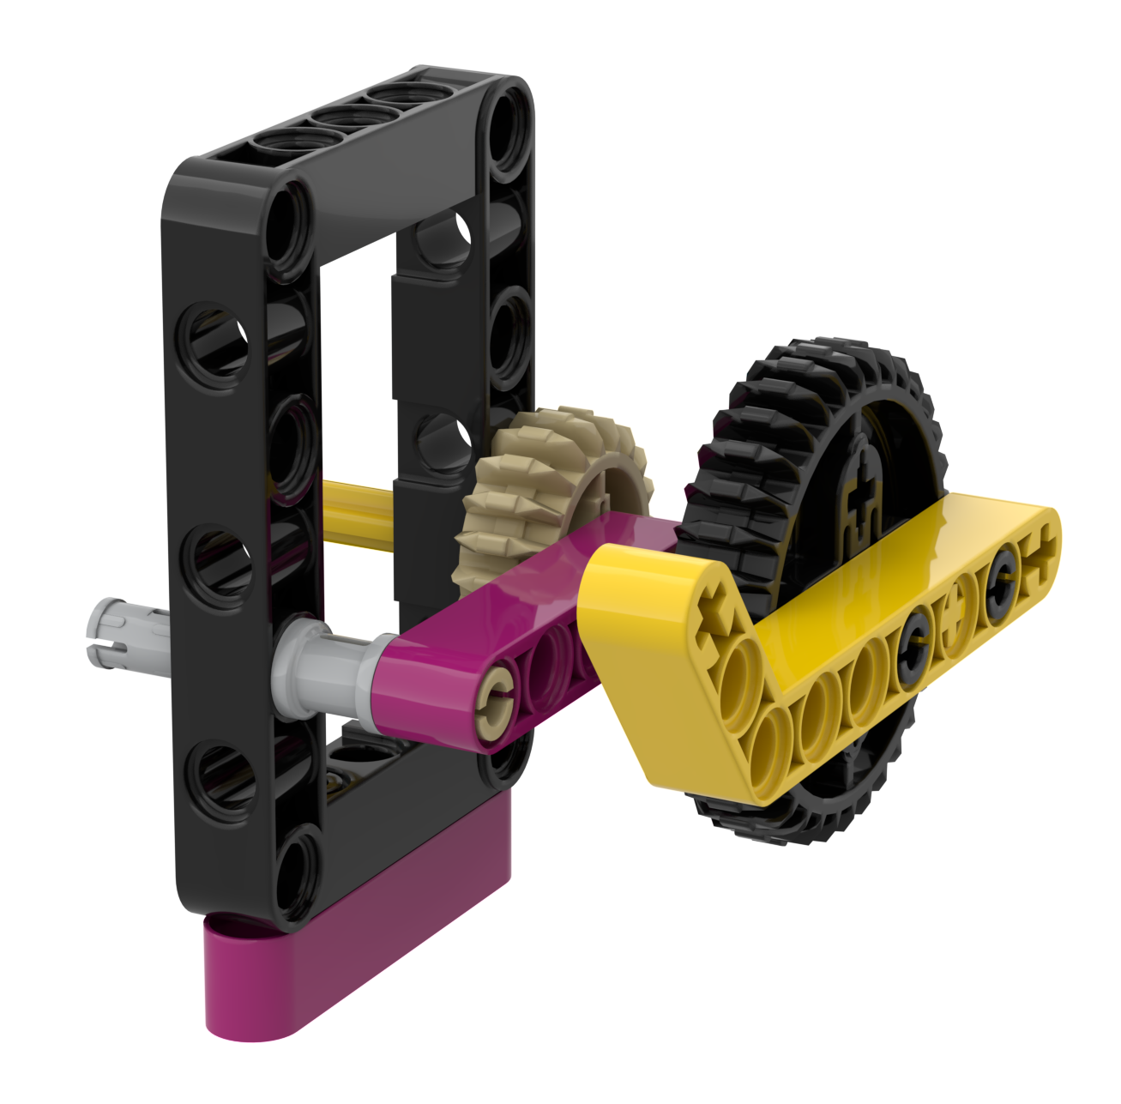
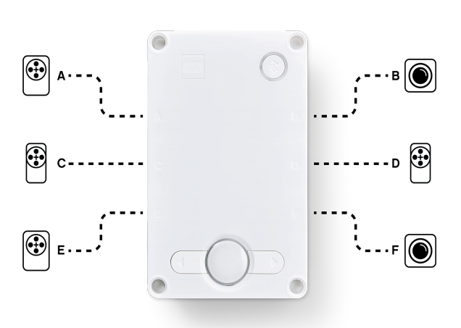
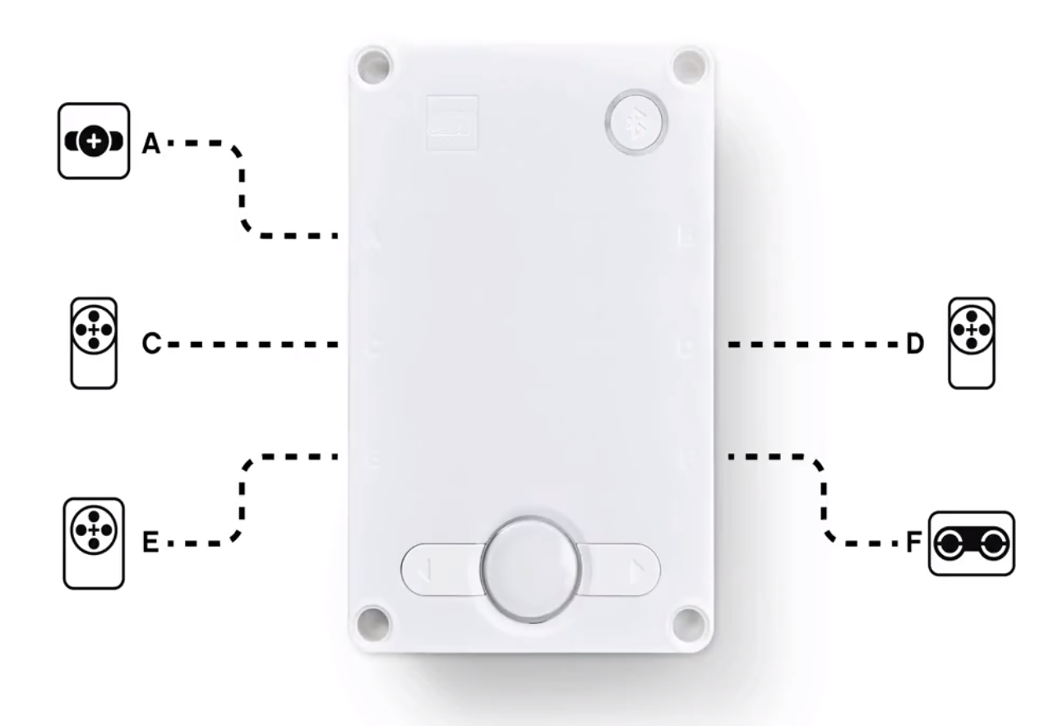
Attachment arm
Create a simple attachment arm for Droid Bot IV for the Large Motor connected to Port D
Droid Bot IV Configuration

Slide 8
Challenge 1: Learn about stall with DROID Bot IV
Create one program with stall detection turned on and one with stall detection turned off.
Using Droid Bot IV or similar, program the motor to turn 1000 degrees.
Add a beeping sound after the motor command.
Hold the arm with your hand to prevent motor from completing 1000 degrees. Hold for a couple of seconds.
Compare what happens in each program. Will the sound play in both or only one program?
set_stall_detection(True)
set_stall_detection(False)
Cause a stall by holding the liftarm and preventing it from turning. Hold if for a second of two

Slide 9
Challenge 1 solution
Stall detection “on” allowed the code to move on to the next line even when the arm got stuck
motor = Motor('D')
motor.set_stop_action('brake')
motor.set_default_speed(30)
motor.set_stall_detection(True)
motor.run_for_degrees(1000)
hub.speaker.beep()
motor = Motor('D')
motor.set_stop_action('brake')
motor.set_default_speed(30)
motor.set_stall_detection(False)
motor.run_for_degrees(1000)
hub.speaker.beep()
The beep plays even if you hold the arm and prevent it from moving.
The beep will not play until you release the arm and allow the motor to complete its move

Slide 10
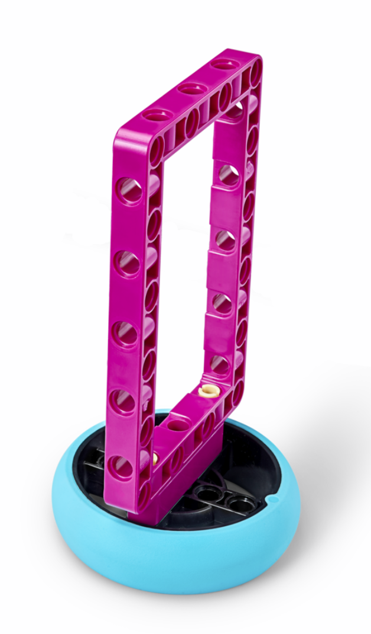
Challenge 2: Pick up object (ADB challenge)
Drive forward, pick up a hoop and return to the start
Make sure to use stall detection in case the motor gets stuck while trying to collect the hoop

Slide 11
Challenge 2 solution
motor = Motor('D')
motor.set_stop_action('brake')
motor.set_default_speed(30)
motor.set_stall_detection(True)
motor_pair = MotorPair('A', 'E')
motor_pair.set_stop_action('brake')
motor_pair.set_motor_rotation(27.63, 'cm')
motor_pair.set_default_speed(50)
motor_pair.move(10, 'cm')
motor.run_for_degrees(100)
motor_pair.move(-10, 'cm')
Configure motors. This program is configured for the ADB robot and large SPIKE Prime tires.
Turn stall detection on in case it was turned off in an earlier program
Move forward up to your object
Rotate the arm up to pick up the hoop
Move back to starting point

Slide 12
Extensions
Think about situations in FIRST LEGO League when stall detection would be helpful
When might the robot get stuck?

Slide 13

CREDITS
This lesson was created by Arvind Seshan for SPIKE Prime Lessons
More lessons are available at www.primelessons.org
This work is licensed under a Creative Commons Attribution-NonCommercial-ShareAlike 4.0 International License.

